Slide 1

…IMDB MOVIES ON GROSS ANALYSIS…
ProJecT Assigned By:
V.Saai Krishna
D.Bhanu Prakash
T.Sampath

Slide 2
Objective
To analyze the box office earnings of movies, looking for trends and connections between factors like genre, release year, total earnings, and reviews and Rating. The goal is to understand how these elements affect a film's financial success and to provide useful insights for filmmakers and marketers
Movie URL
URL='https://www.imdb.com/search/title/?title_type=feature&release_date=2022-01-01,2024-10-31&countries=IN'

Slide 3



Tools Are Used In Web Scraping On IMDB
Extracting Data
Data Cleaning
EDA
Conclusion

Slide 4
Visualization On The Data

Slide 5
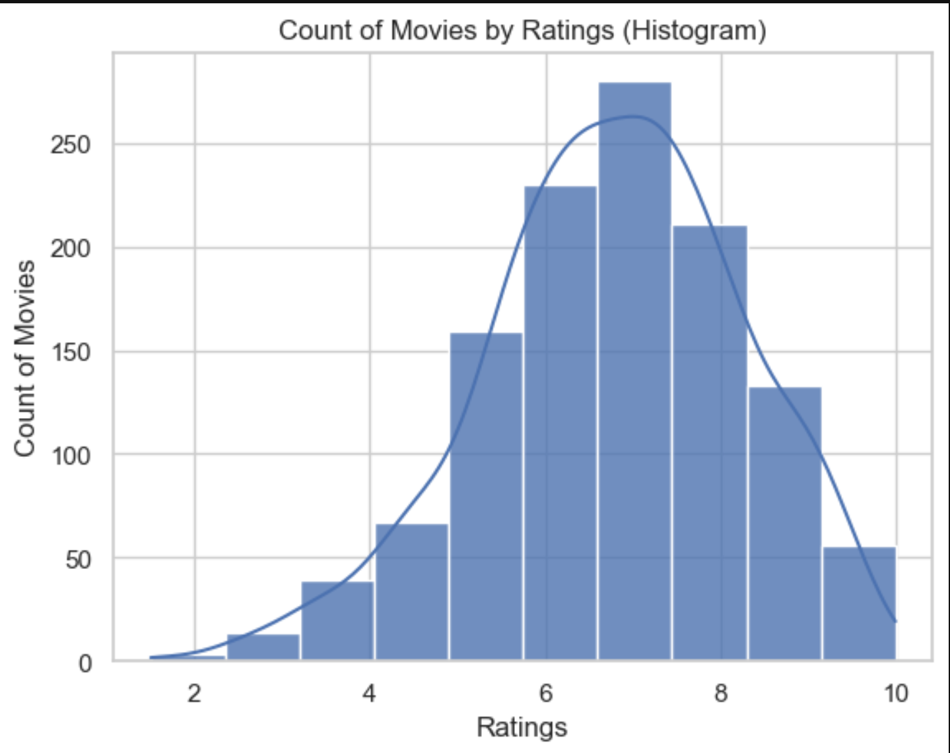
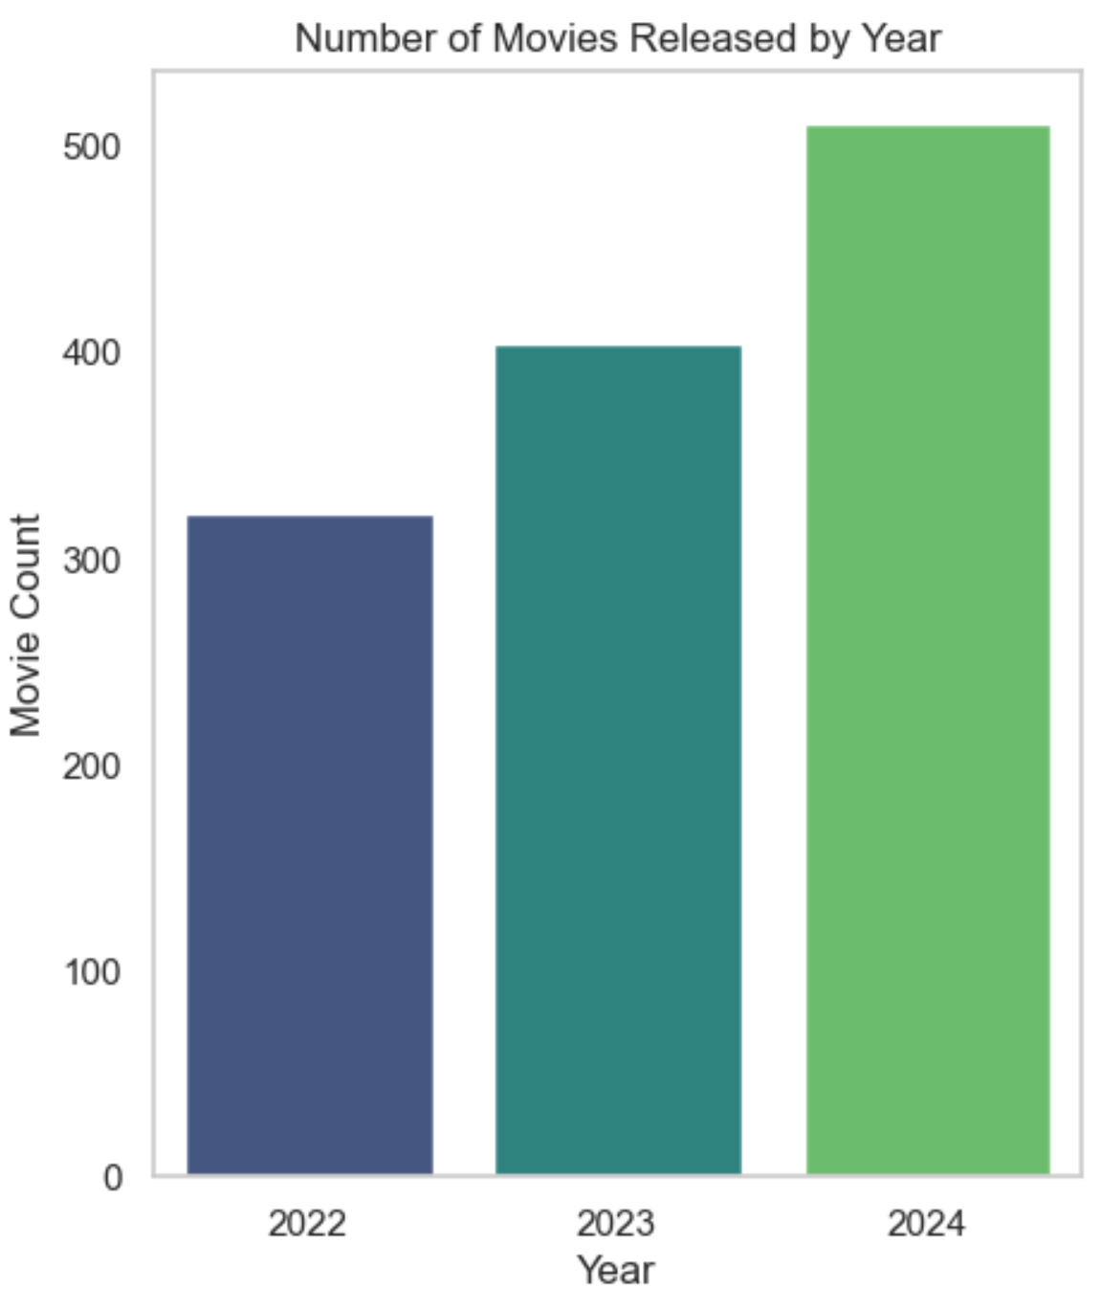
We Can Observe that 2024 has maximum number of movie released .
In The histogram Plot Shows Movies Ratings is to easily understand the Ratings of movies
The histogram shows that the majority of movies received ratings around 7.
The Fewer movies receive ratings that were much higher and lower

Slide 6
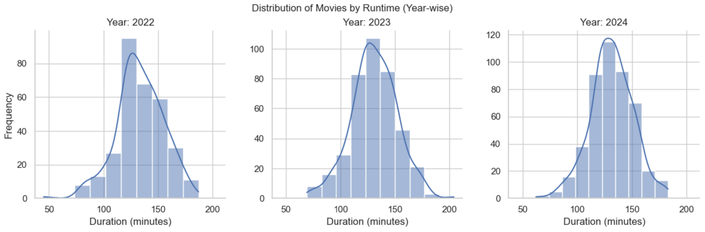
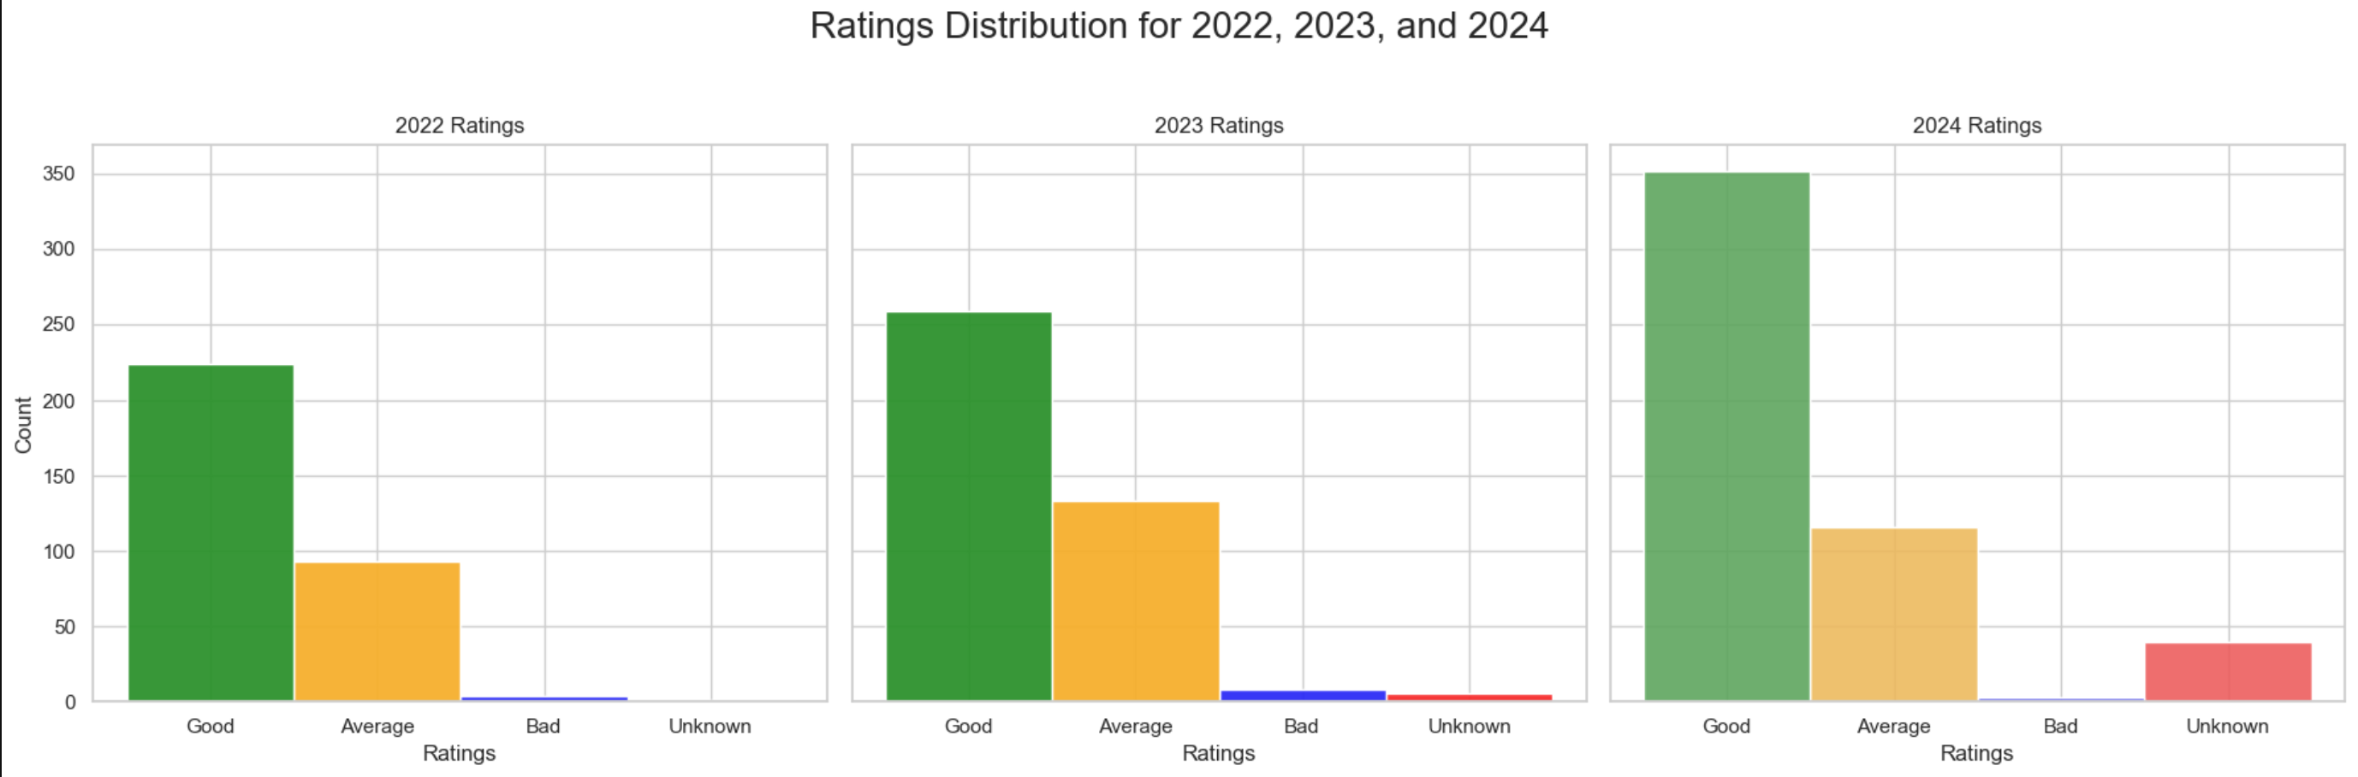
This Visualization is about the Movies with rating
The movies we categorised into GOOD,AVERAGE,BAD based Upon ratings
This Visualization is on distribution of movies by runtime
The data suggests that the average runtime of movies has been increasing over time.

Slide 7
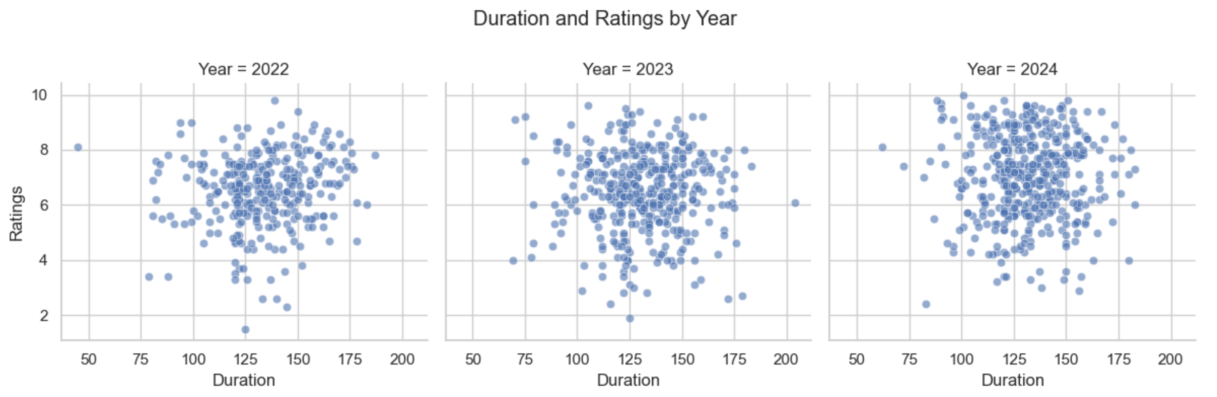
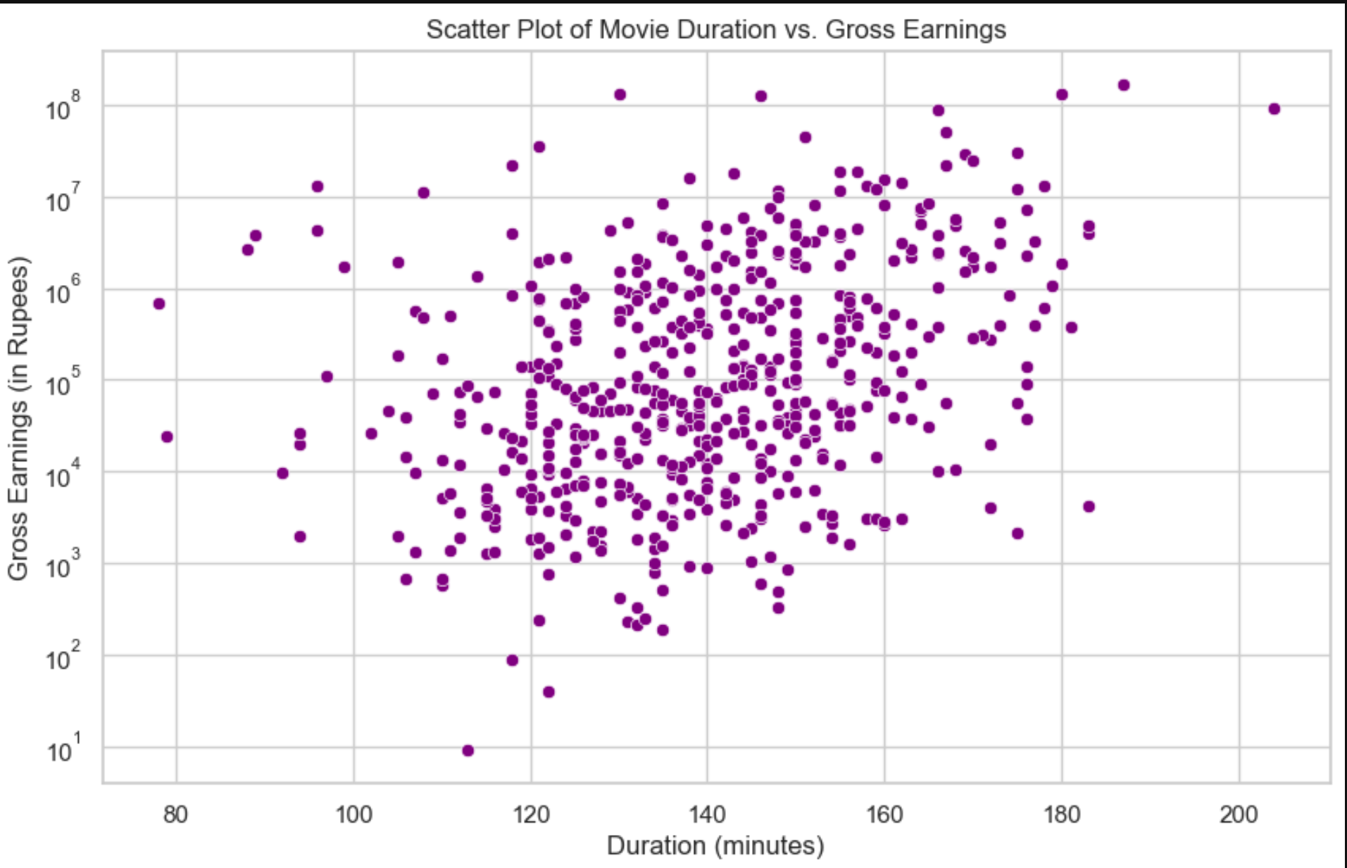
Scatter Plot
This visualization on movie duration vs gross By Scatterplot
correlation between duration and earnings, meaning that longer movies tend to earn more than shorter ones.
Here we Can See that Some of Them outliers on Gross
The trend appears to be that movies with a longer duration have higher ratings
It is Visualized by Scatterplot

Slide 8
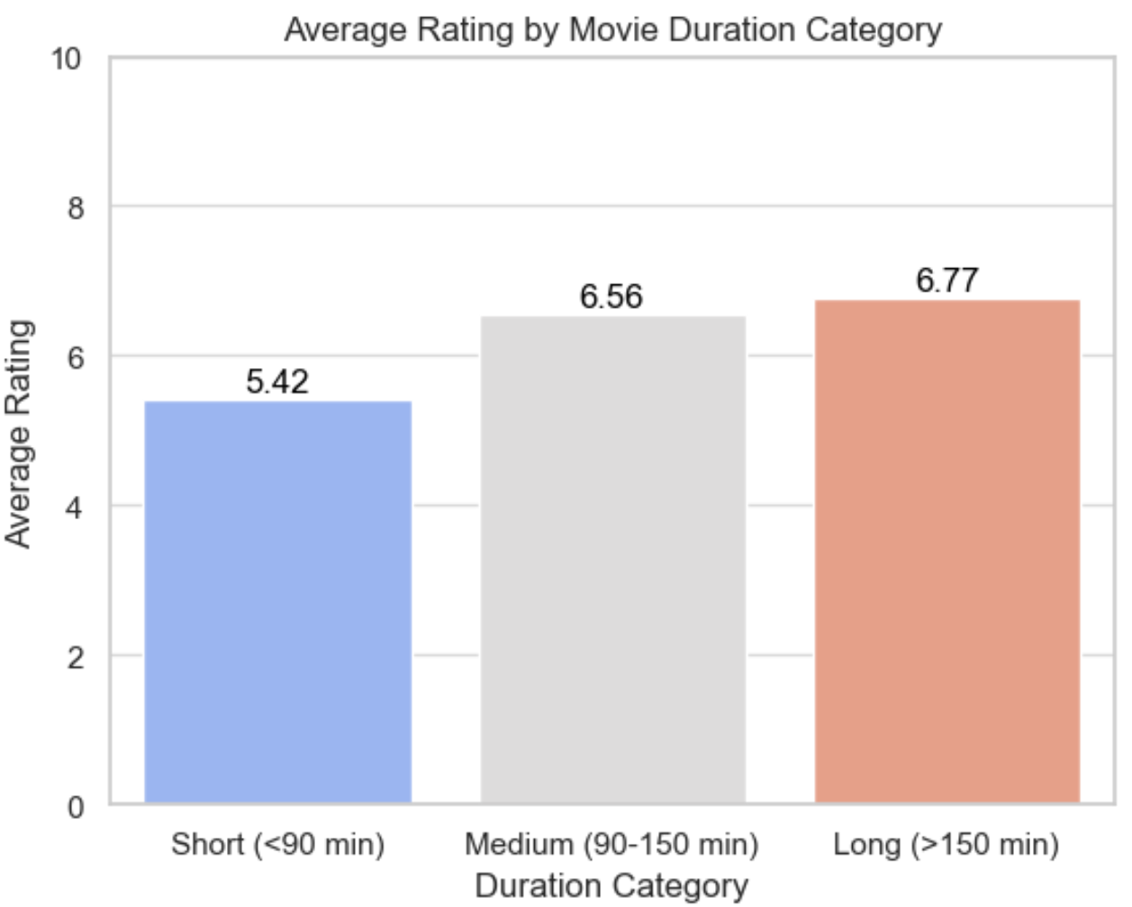
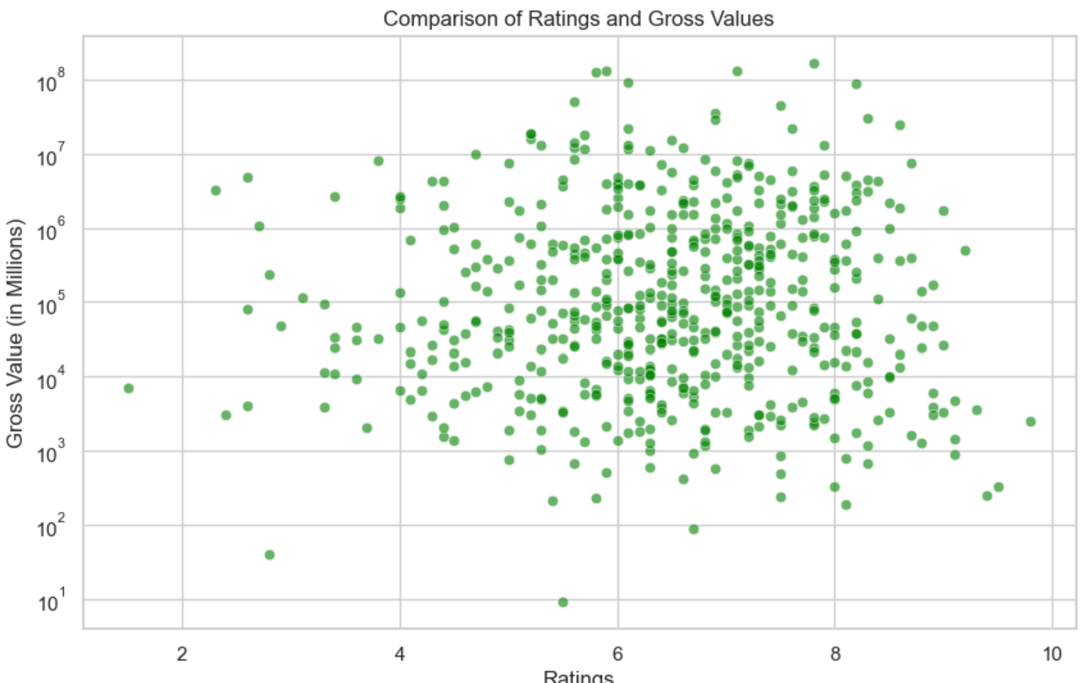
This Visualization is based upon comparison of rating And Gross Values
The bar chart shows that the average rating of movies is higher for movies that are longer on overall Years

Slide 9
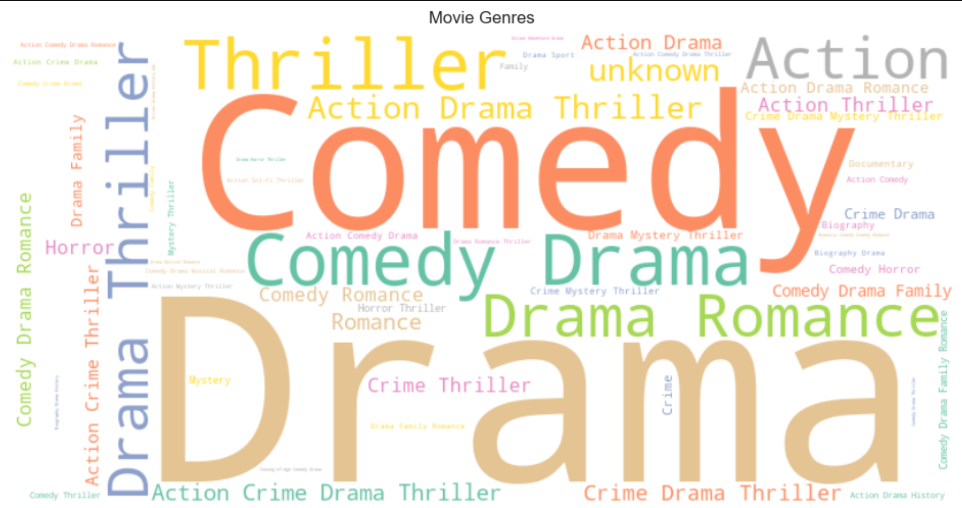
This word cloud represents the popularity of different movie genres. The size of the word reflects the number of movies that belong to that genre.
It's evident that "Drama" is the most popular genre, followed by "Comedy", "Thriller" and "Romance“ Etc.

Slide 10
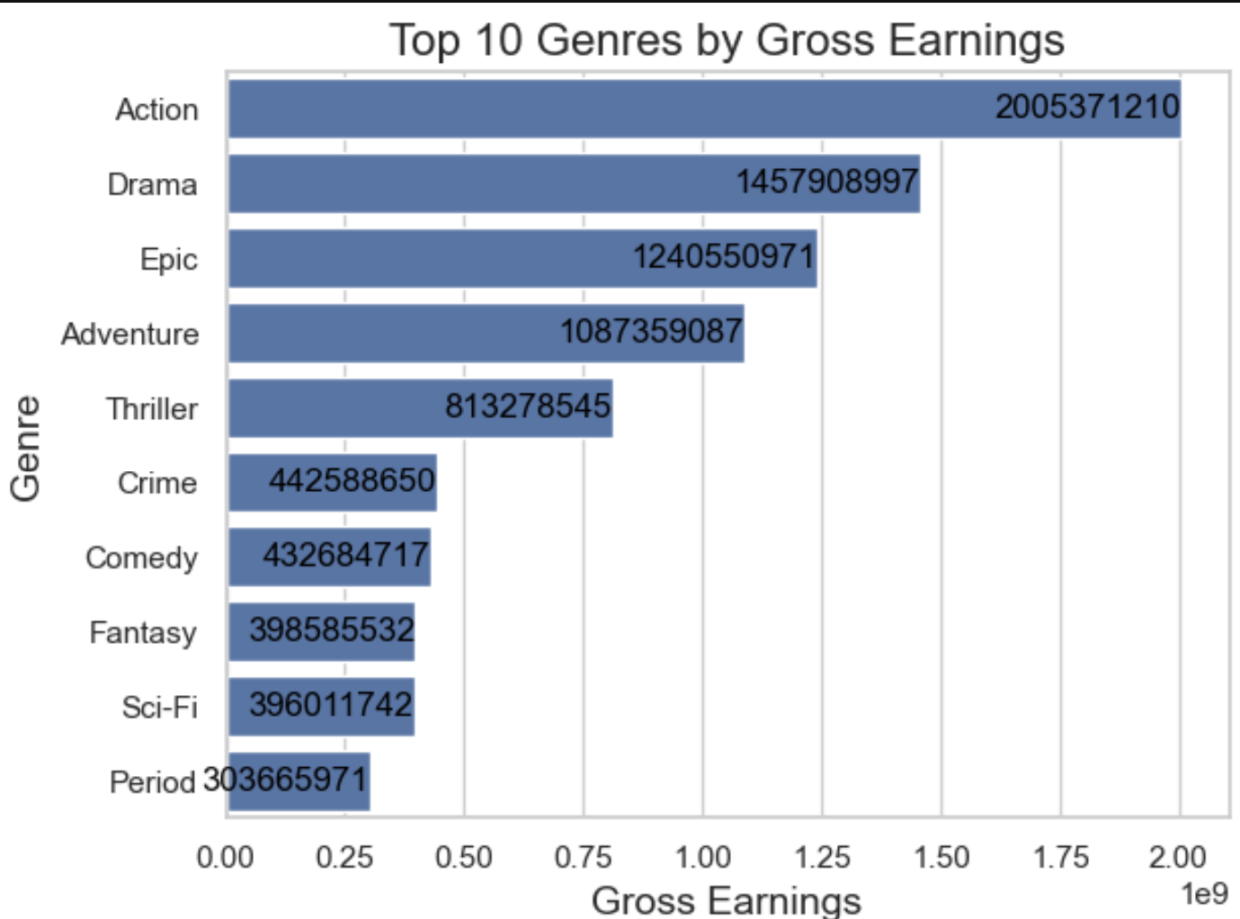
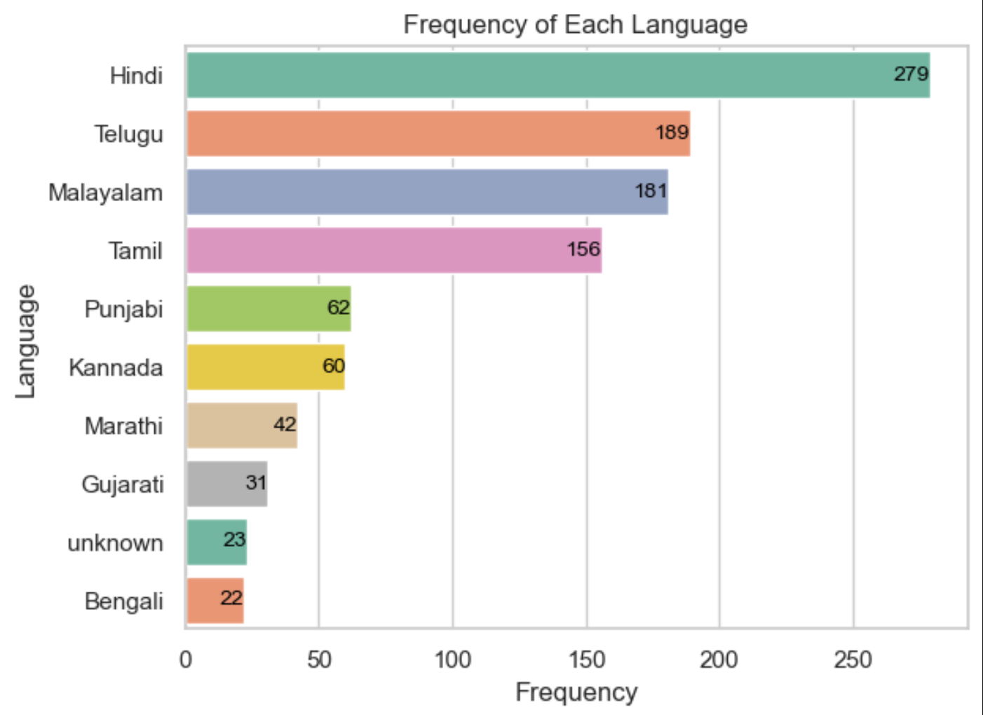
Action is the top earning genre, with over 2 billion dollars in revenue
Period movies earn the least, with just over 300 million dollars in revenue
Hindi is the most frequent language with 279 occurrences
Following Hindi are Telugu with 189 occurrences, Malayalam with 181 occurrences, and Tamil with 156 occurrence

Slide 11
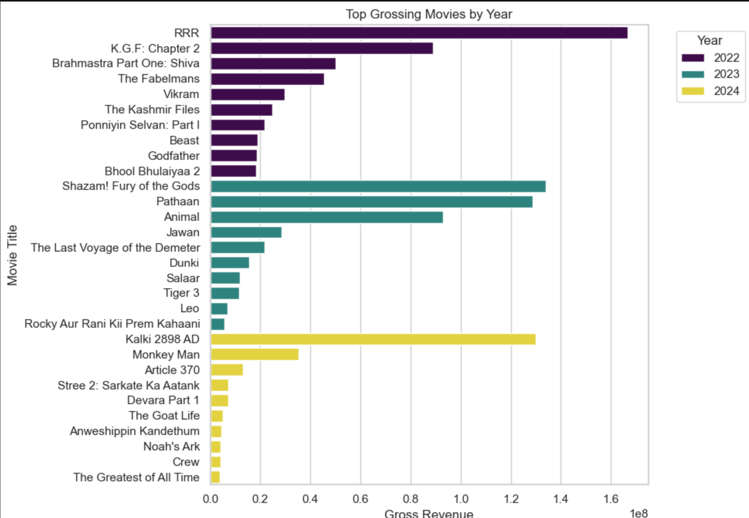
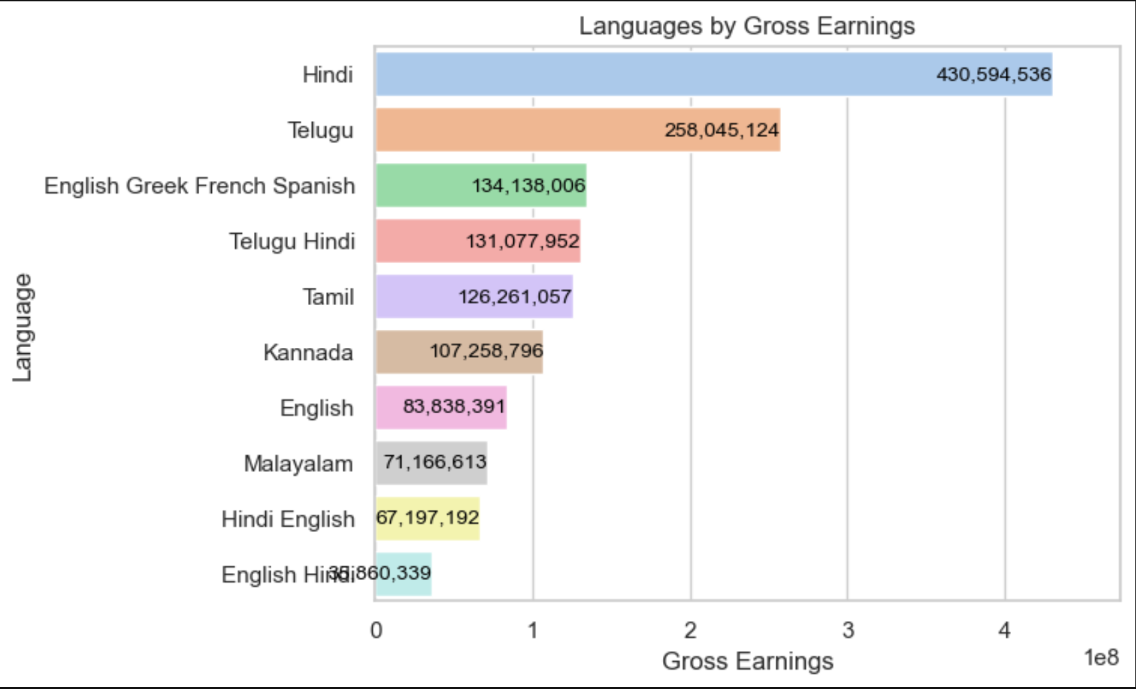
Hindi has the highest gross earnings with 430,594,536
The lowest gross earnings were for movies released in English Hindi with 860,339
The chart shows the top-grossing movies by year
RRR was the highest grossing movie of 2022, with the highest gross of almost 1.6 billion
In 2023, Fury Of The God was the top-grossing film with a gross of 1.2 billion
Kalki 2898 AD was the top grossing film of 2024, with the highest gross of 1.3 billion

Slide 12
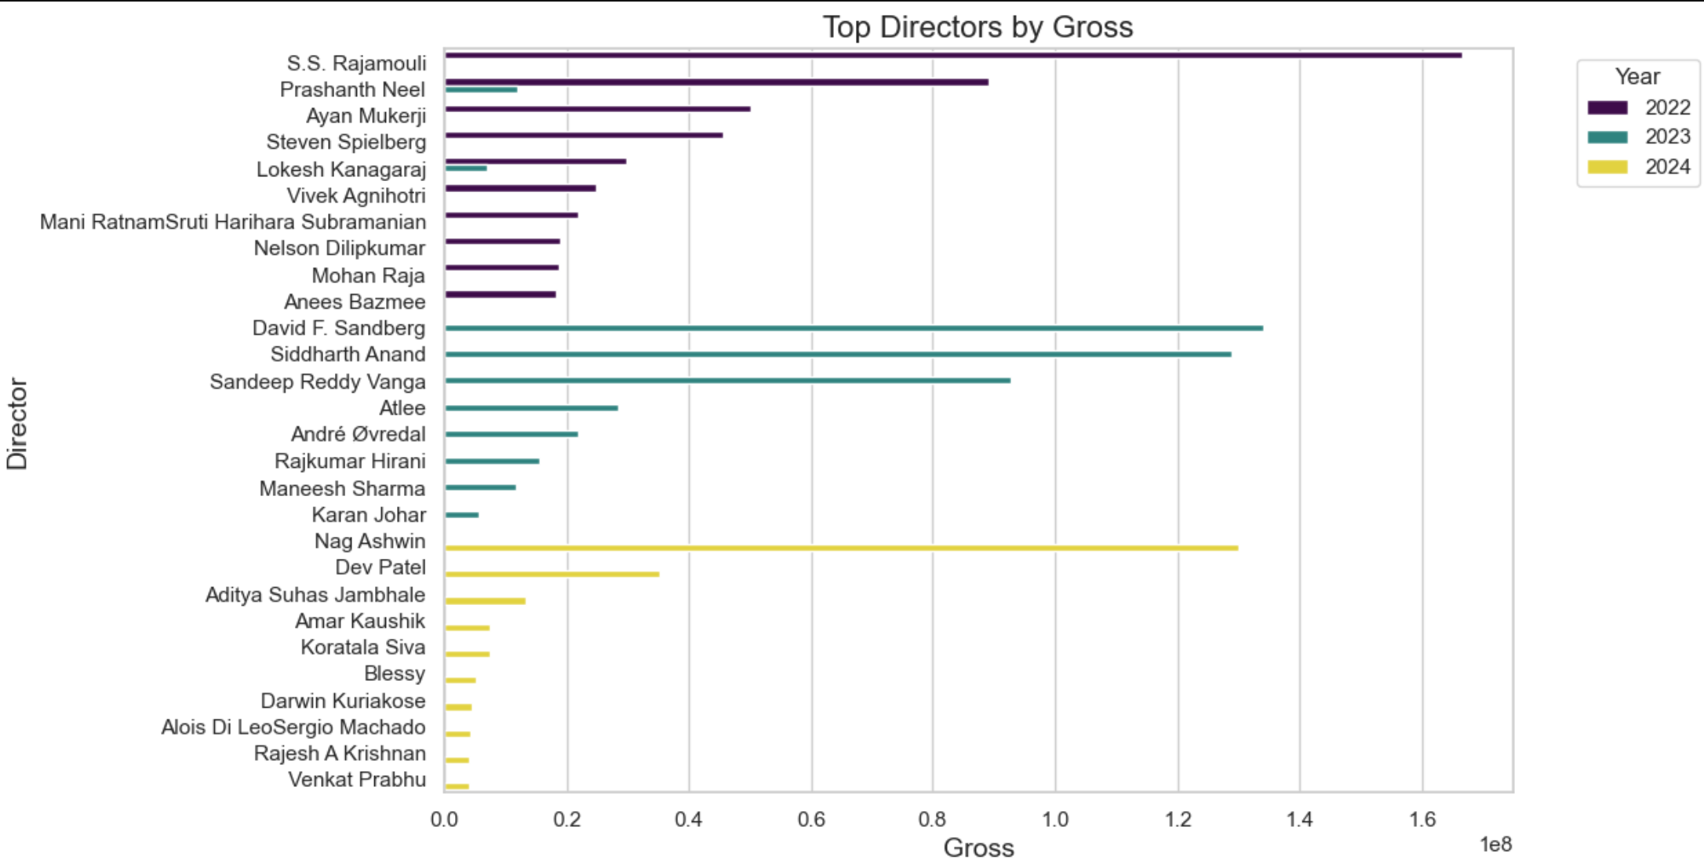
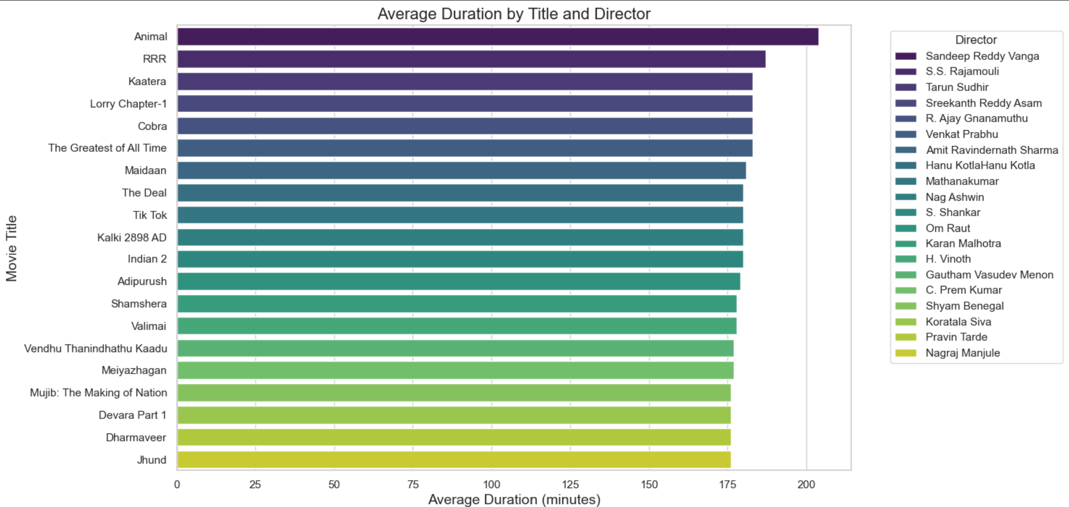
Bar Graph
The movie Animal has the longest average duration at around 205 minutes. It was directed by Sandeep Reddy Vanga,
Jhund has the shortest average duration at around 175 minutes
The Visualization is based Upon Director and by Gross
Here we can see that SS. Rajmouli has Top gross of 1.65 billions in the year of 2022
In the year of 2023 David Sandberg has Top gross 1.34 billions
In the Year of 2024 Nag Ashwin has top gross of 1.45 billions

Slide 13
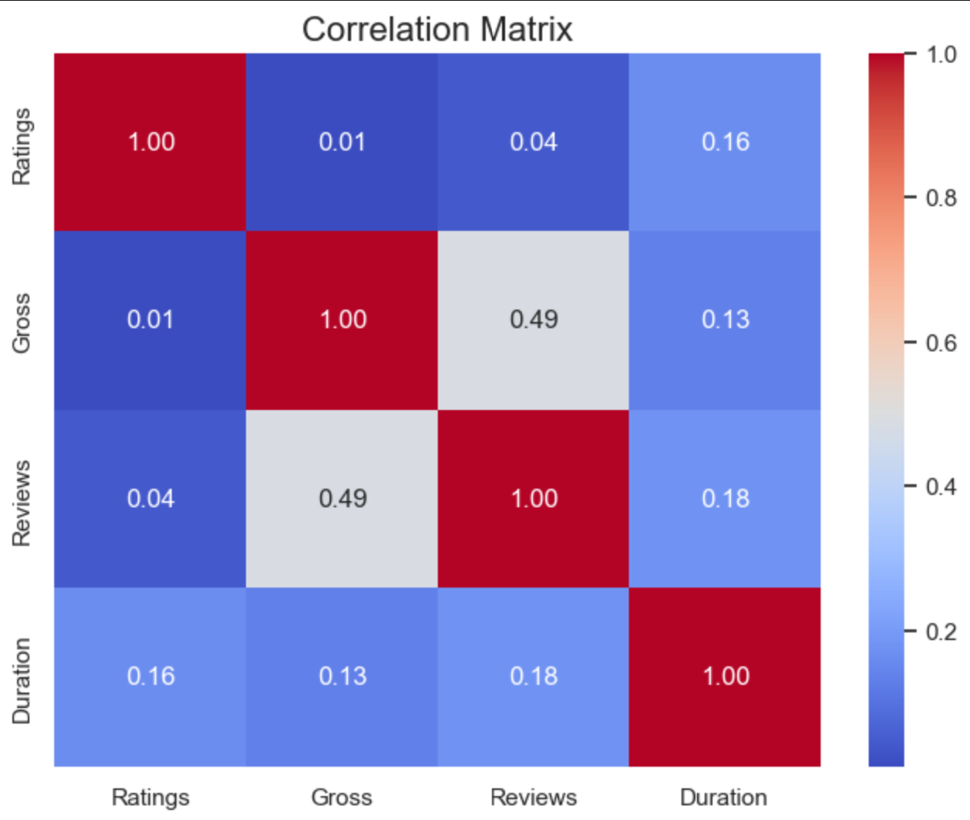
Correlation Matrix On Ratings,Gross,Reviews,Duration
Gross and Reviews have the strongest positive correlation (0.49), meaning movies with higher gross revenue tend to have more reviews.
Duration and Reviews have a moderate positive correlation (0.18).Ratings, Gross, and Duration have very weak correlations with each other, suggesting they are largely independent.

Slide 14
Conclusion:-
A few prominent directors may dominate in terms of gross revenue, showing that established directors tend to attract larger audiences or higher box-office earnings.
Based on the gross revenue data, specific genres like Action, Drama, and Comedy (if relevant) tend to generate higher box office revenues.
There may be a moderate correlation between movie ratings and gross revenue, suggesting that movies with higher ratings tend to perform better at the box office
Movies in certain languages, such as Hindi, English, or Telugu, might dominate the gross revenue figures, indicating that these languages have larger market reach.
Certain actors might appear more frequently in high-grossing films, indicating that their presence significantly contributes to the commercial success of a movie.
Longer movies, particularly those with an epic narrative structure, tend to generate more revenue, potentially due to their ability to engage audiences for extended periods and create a more immersive experience

Slide 15

....THANK YOU….

